Slide 1
TECHNOLOGICAL EDUCATIONAL INSTITUTE OF THESALY
DEPARTMENT OF COMPUTER SCIENCE AND ENGINEERING
STUDENT: JOHN CHANTZIS
SUPERVISING PROFESSOR: IATRELIS OMIROS
DISSERTATION
Development of Graphical User Interface for a Software Simulating Heat-Transfer Phenomena
Notes:
Good morning and thank you for coming. I hope not to tire you too much.
I'm John Chantzis and this is my dissertation,
the development of a graphical environment for simulation software of heat transfer phenomena.
<number>

Slide 2
Subject Description
The subject of this work is the development of a graphical user interface (GUI) for an existing software (bark) that is executed at the command line.
The application 'bark' enables dimensional transitional simulation of heat transfer phenomena in walls with multiple layers and is already used for teaching purposes in the Department of Mechanical Engineering. Accepts XML input files and exports the results to ASCII files.
The ultimate goal of this work is a user-friendly interface that can create the input file, perform simulations and finally display the results.
Notes:
As you realized I made a GUI for a program that already exists, the bark.
~ About the bark:
It is an application which simulates heat transfer phenomena on walls with multiple layers,
wherein each layer is a different material.
Receives an XML input file with a specific structure to output a file with the simulation results.
My own dissertation uses this application to make graphs with the output data.
<number>

Slide 3
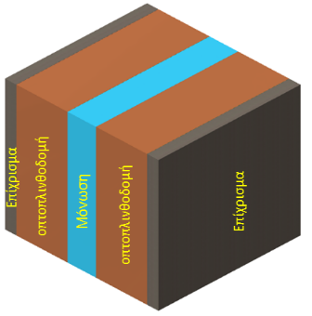
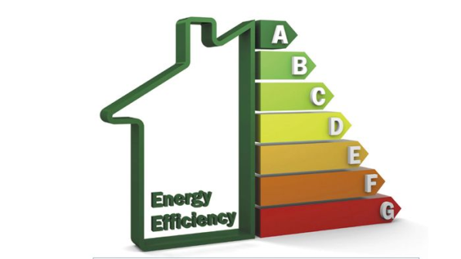
Application bark
The application 'bark' is used for heat transfer simulations in various walls which are made of layers of different materials in the interior and exterior of the building but also inside the wall.
The word bark is used as a simile representing the multiple layers of a wall.
Notes:
The practical use of bark is to perform conclusions on the performance of a wall under various conditions (eg If you look at the sun and how many / which hours a day) A useful application of the program is the construction of energy buildings, ie affordable energy .
Research proved that a percentage of over 30% of energy consumption in Greece concerns buildings and it's an annually increasing percentage. Thus saving energy through energetic buildings offer significant gain performance and money.
The bark program is already used in teaching the course "Computational Transport Phenomena" of the department Mechanical - Engineering. The problem is that students struggled to manually edit the XML file and find it difficult to understand the essence of the exercise ...
<number>

Slide 4
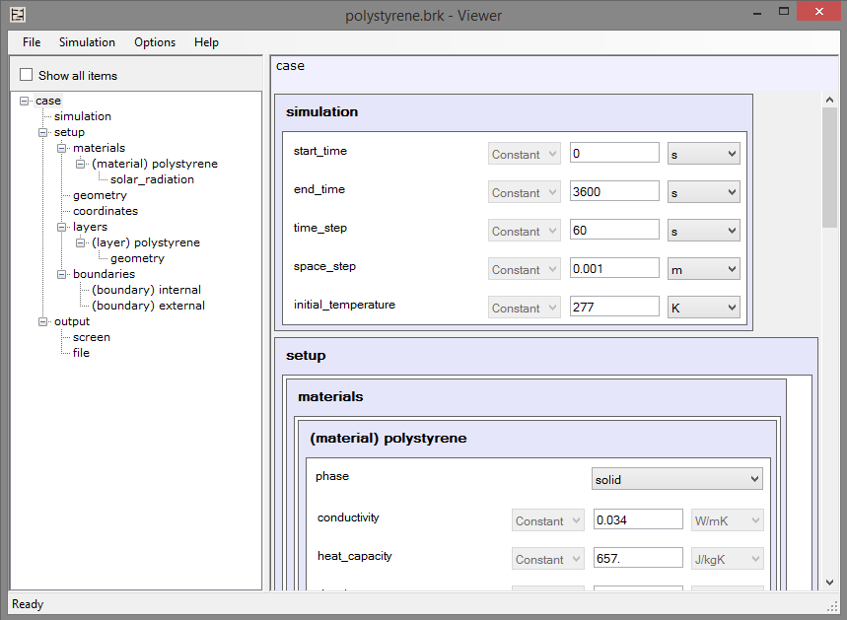
Graphical Interface of Bark_GUI
Notes:
~ Here is when my dissertation takes place, the GUI Bark_GUI.
It opens and creates XML files with the structure we want and provides easy editing of the content without someone knowing the language XML, in order to perform the simulation in bark.
[Analysis of the Controls of the main window]
Key Controls main window is TreeViewer and ElementViewer.
The ElementViewer contains all the Controls for data processing of each element.
The TreeViewer shows the structure of the open XML file, all elements comprehensively.
In TreeViewer the user can choose an item and automatically update the ElementViewer right to show only the contents of the
selected item. You can also right-click to add, remove, rename specific data and move
an item to another location.
The Status Message below shows the status of the program (usually always displays Ready but on slower computers it is very useful).
And above the ElementViewer is displayed the path of the selected element from left (just to know who you are).
~ I'll explain and contents of ElementViewer later, but for now let us see an XML file ...
<number>

Slide 5
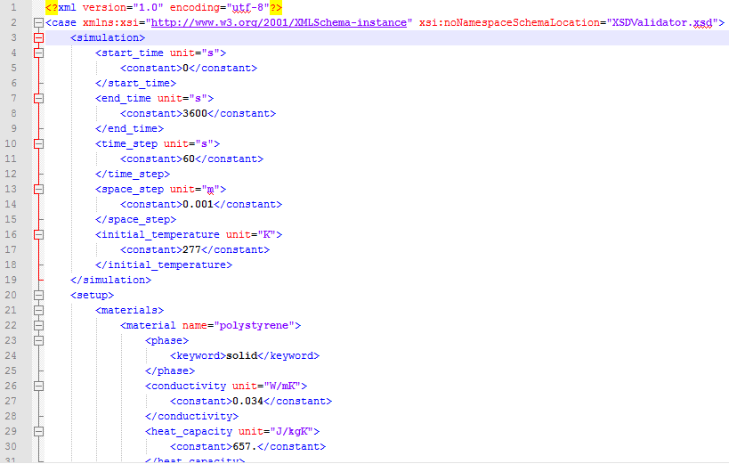
Sample of data input file type XML
Notes:
~ This is an XML file that is required to perform the simulatation.
Amended after consultation with the Professor Onoufrio Charalambous to fit properly both bark and GUI (XSD).
[I show data in XML]
We can see the 'case' which is the Root Element of the XML, it's two base children: simulation and setup and their contents.
The same structure is obviously in the GUI as well.
[Switch to the previous slide to show the assignment of the elements in the tree]
... And the same data ...
[Switch to look and the matching of data in ElementViewer]
Different measurement units are supported. Also some elements may have another name [show the material name = "polystyrene"]
And finally we see the content which may have an element XML, constant, keyword ...
[Switch to look different in each Control]
There are also the reference and variable elements which we will see later.
<number>

Slide 6
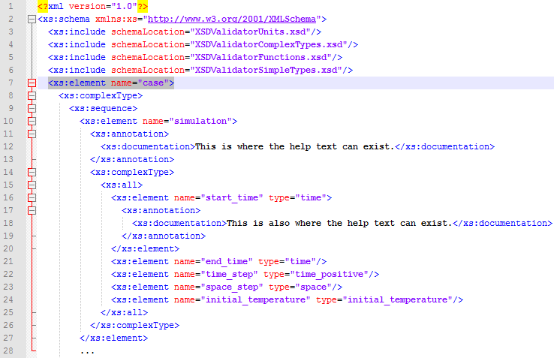
Sample of schema file type XSD
Notes:
~ The biggest problem I had with the dissertation was to make the application dynamic.
That's why it was required among others to build a schema file for the XML and what we see is a sample file XSD.
The entire schema is broken into five parts for simplification.
This schema defines the structure of the elements in the XML files.
The types of the elements are defined in other files, this file mainly shows the structure.
~ I will not get deeper into this part not to tire you with a lot of code, just to mention that the admin can write help text in the data that appears in the GUI after mouse-hover on each item.
<number>

Slide 7
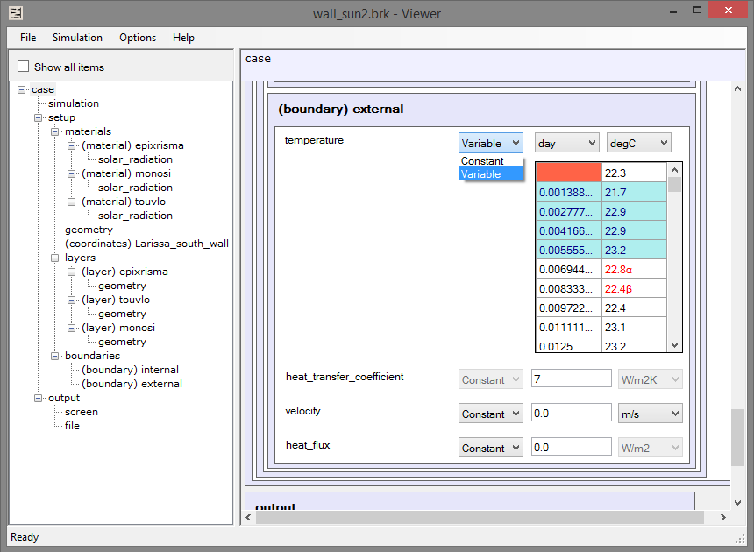
Graphical Interface of Bark_GUI
Notes:
Here we see a Variable element which is represented by a two-dimensional array of values.
Opposing to the constant value the variables have two units wherein the first usually is time (i.e. changing the value in time).
The first option (dropdown) is to change the type of variable to constant and vice versa. The permitted types are defined in one of the XSD files.
In the variable control it appears that the user made some mistakes like leaving the first box empty or typing letters in the other two boxes instead of numbers. There is a value validation control on each item and what value is considered valid is defined in the XSD.
Generally all the restrictions we wish to add, are contained in the XSD files to be able to change them without the need to create a new Project-GUI. (The 'dynamicity' I mentioned earlier)
<number>

Slide 8
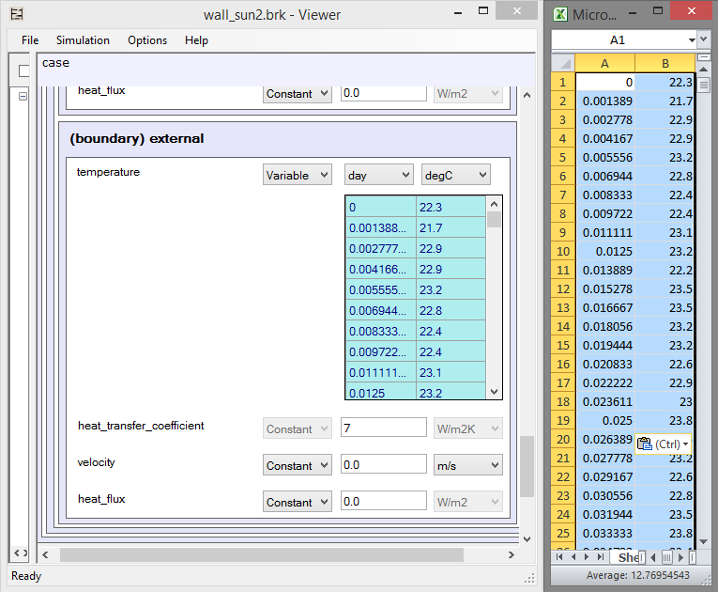
Variable Element
Notes:
Because the variable can take large amounts of data (an exercise had two tables from 5000 lines each panel) I implemented compatibility with Excel type files.
One can copy data tables to and from Excel.
<number>

Slide 9
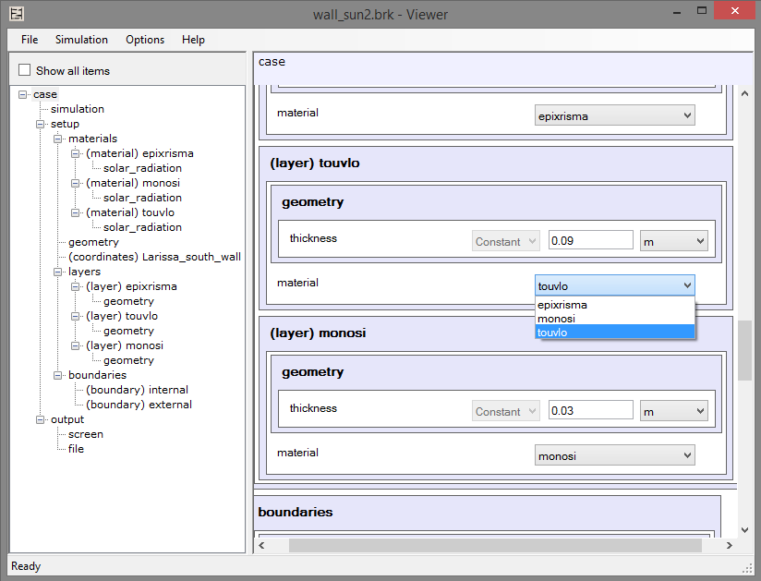
Graphical Interface of Bark_GUI
Notes:
~ The last control that you see is the Reference.
This is a little more complicated because it does not have a specific value. It has a symbolic value to indicate that it refers to another item.
As we can see in the example it is used to denote what materials exist and which layer of the wall is which material. This way you do not need to put the same values ​​in the layers using the same material.
I said that it is more complicated because, unlike the other elements, it is created after loading the XML file and the possible values ​​are not defined in the XSD, but change while the user is processing the data.
In short, if we add another material, the Reference control is refreshed and has an extra possible value. Similarly with the deletion and renaming.
~ These were the controls and their use ...
<number>

Slide 10
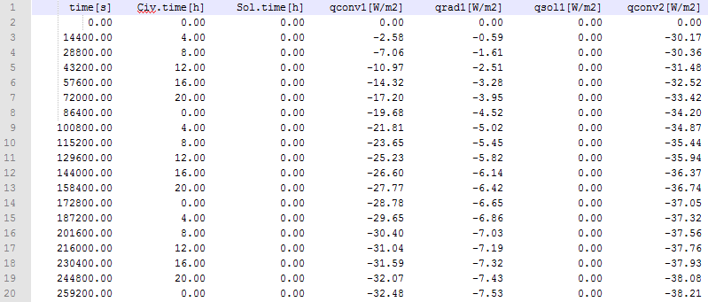
Sample of output data file of bark
Notes:
After the user has finished editing the data using the GUI, he can execute a simulation (by running the bark application) in order to see the results.
This is a sample of an output file of the bark (has more columns and lines) and has the form that you see
The first line has the titles of data and other data are separated by tabs per column.
Because hardly anyone sees conclusions from such a file, let's create a figure ...
<number>

Slide 11
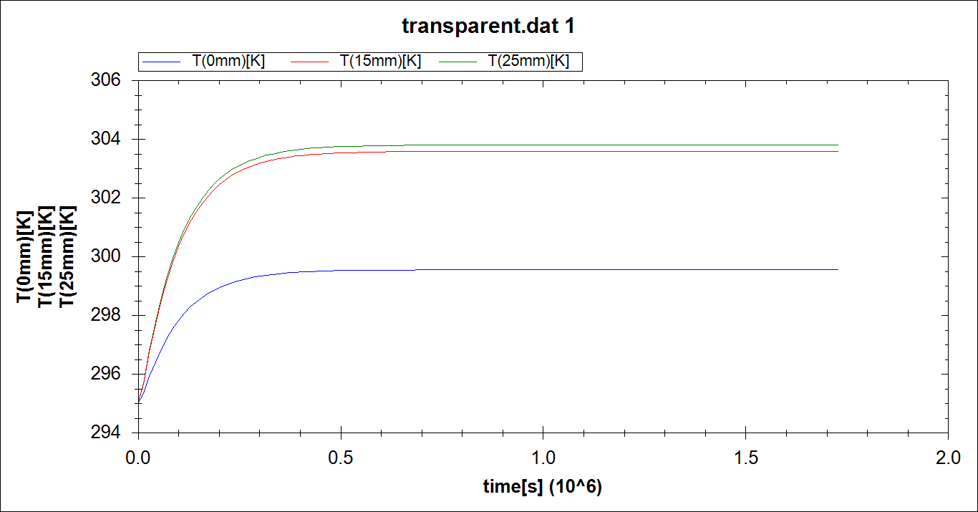
Graph result of output data simulation
Notes:
This is the purpose of the second part of the dissertation, the graphical representation of the output data.
Reads the file that we previously saw in order to take the data and store it in a format that can be used.
The library ZedGraph is used for creating graphs.
Now the student can draw conclusions about the materials that can be used on the wall for the best solution with the input data he provided.
<number>

Slide 12
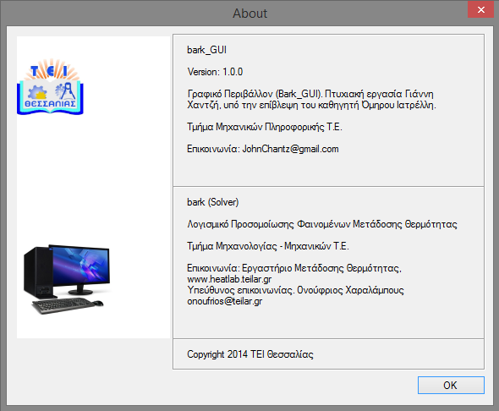
End of Presentation
Notes:
What we saw, now in practice ...
<number>

